Slide 1

Cascaded 8-Bit Adder
SCHOOL OF
ELECTRICAL AND
ELECTRONIC
ENGINEERING
Electronics 1 Laboratory
Dr Brian Cogan & Dr Patrick McEvoy
February 2019

Slide 2
Cascaded 8-Bit Adder
In computers, very wide, 32-bit or 64-bit, adders form part of the Arithmetic Logic Unit (ALU) in processors, where arithmetic and other logical operations are performed
In this laboratory, the Vivado tools will be used to examine how a cascaded 8-Bit “Ripple” Carry Adder can be created and tested
Hierarchy, that is code components that are already written, will be used in order to reduce the design effort

Slide 3
1-Bit Adder
A full adder adds binary numbers and accounts for values “carried” in and out
A 1-bit full adder adds three 1-bit numbers, often written as: a, b, and c_{in}
Use animation to illustrate the sequence
Input |  |  | Output
a | b | c_{in} | s | c_{out}
0 | 0 | 0 | 0 | 0
0 | 1 | 0 | 1 | 0
1 | 0 | 0 | 1 | 0
1 | 1 | 0 | 0 | 1
0 | 0 | 1 | 1 | 0
0 | 1 | 1 | 0 | 1
1 | 0 | 1 | 0 | 1
1 | 1 | 1 | 1 | 1
1
s
0
Full Adder 0
0
c_{out}
c_{in}
a
b
1
0

Slide 4
Cascaded 8-Bit Adder
A full adder adds binary numbers and accounts for values carried in and out
A 1-bit full adder adds three 1-bit numbers, often written as: a, b, and c_{in}
The animated sequence in the 8-bit adders illustrates the steps taken
0
0
1
1
0
0
1
1
s₀
s₁
s₂
s₃
s₄
s₂
s₁
s₀
1
0
1
1
1
0
0
0
1
c_{out}
Full Adder 7
c₇
Full Adder 6
c₆
Full Adder 5
c₅
Full Adder 4
c₄
Full Adder 3
c₃
Full Adder 2
c₂
Full Adder 1
c₁
Full Adder 0
c₀
a₇
b₇
a₆
b₆
a₅
b₅
a₄
b₄
a₃
b₃
a₂
b₂
a₁
b₁
a₀
b₀
0
1
1
1
0
0
1
1
1
0
1
1
1
0
0
1

Slide 5
Learning Objectives
The objective of this laboratory, is to:
Import:
VHDL behavioural design source code
VHDL library source code
A VHDL simulation (Testbench) code to test the design
Implement the design on the Artix-7 FPGA via the Basys3 development board
Apply signals to the board switches to confirm that the design works as planned

Slide 6
Download files from Brightspace
To prepare for the laboratory, download the following files from Brightspace to your local workspace on the computer:
ByteAdd.vhd
XSE.vhd
ByteAdd_TB.vhd

Slide 7
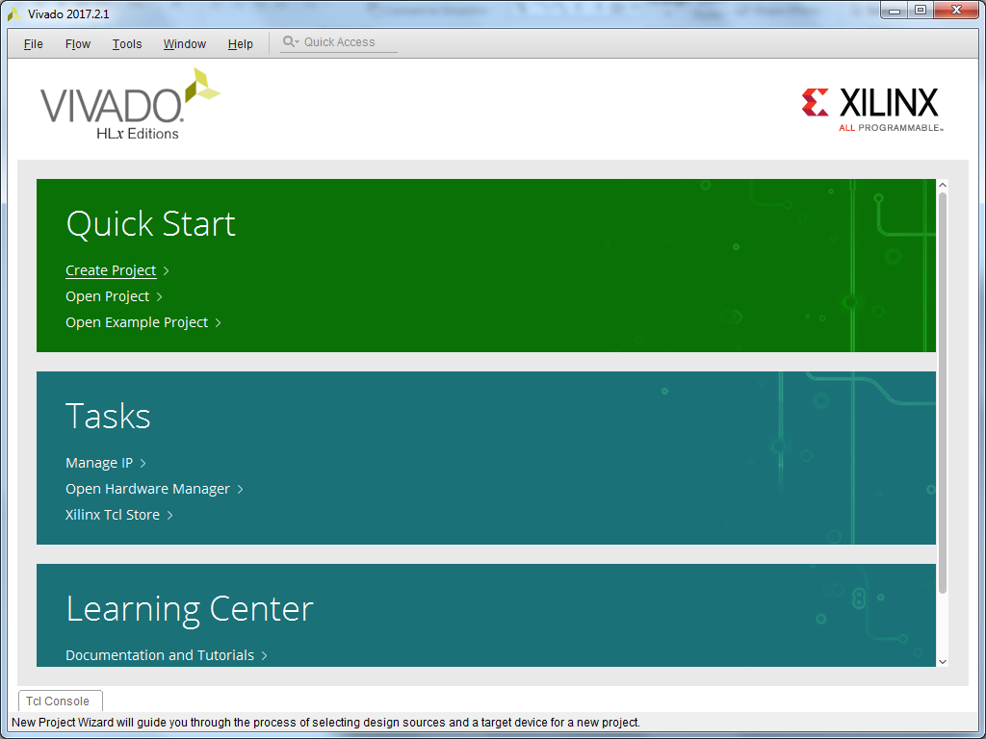

Create a new project

Slide 8

Create a new project

Slide 9
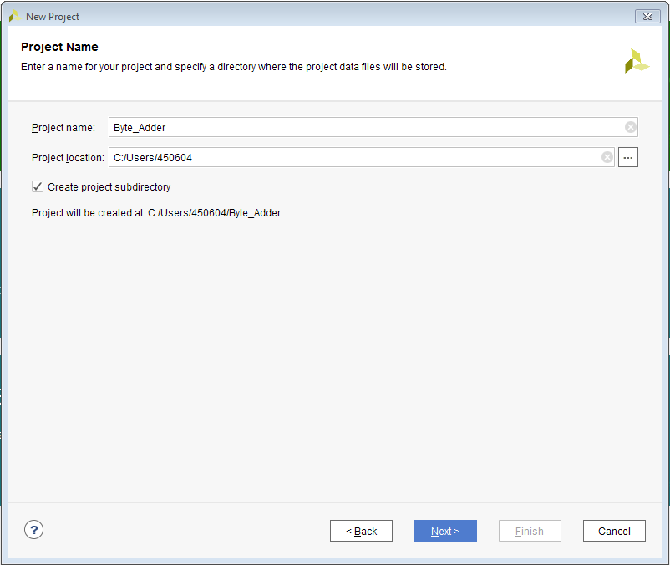
Create a project name and select the location

Slide 10
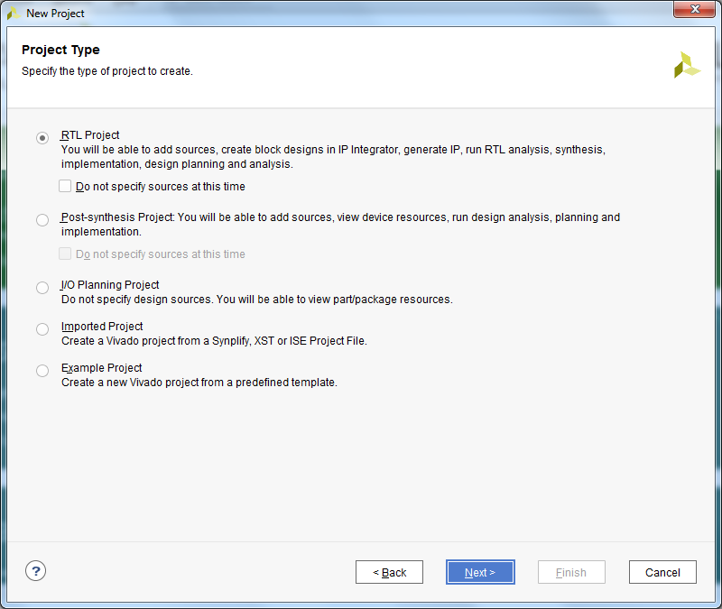
Select Register-Transfer Level (RTL) project

Slide 11
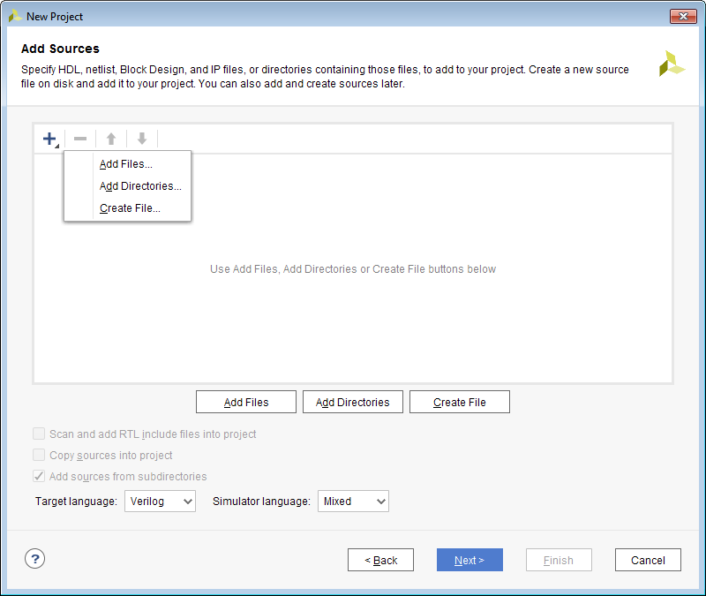
Add source files
From Brightspace, you should have downloaded:
ByteAdd.vhd
This files will be added/copied to the Byte_Adder.xpr project that has just been created
Also, for use later, download:
XSE.vhd
ByteAdd_TB.vhd

Slide 12
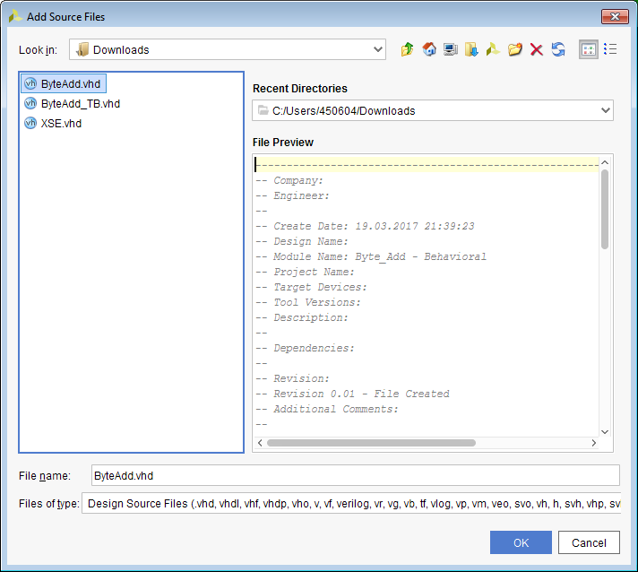
Add downloaded ByteAdd.vhd source file
Add ByteAdd.vhd

Slide 13
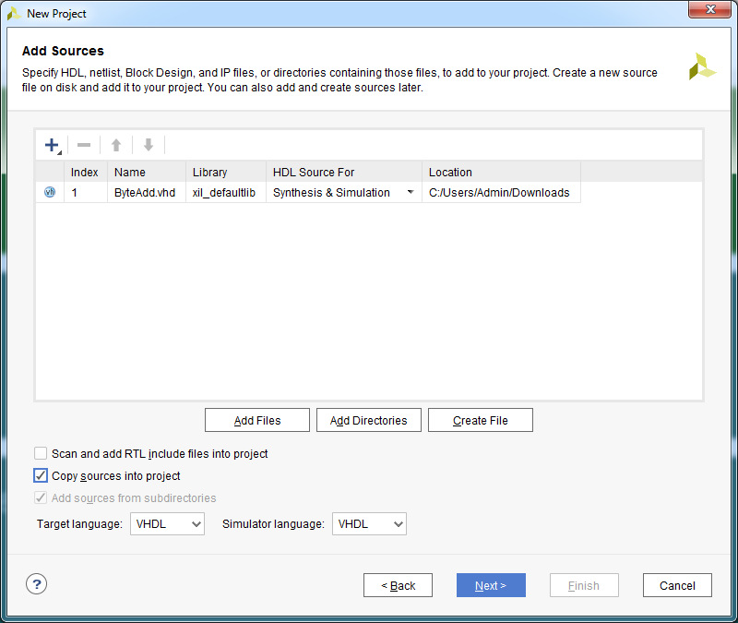
Add source files

Slide 14
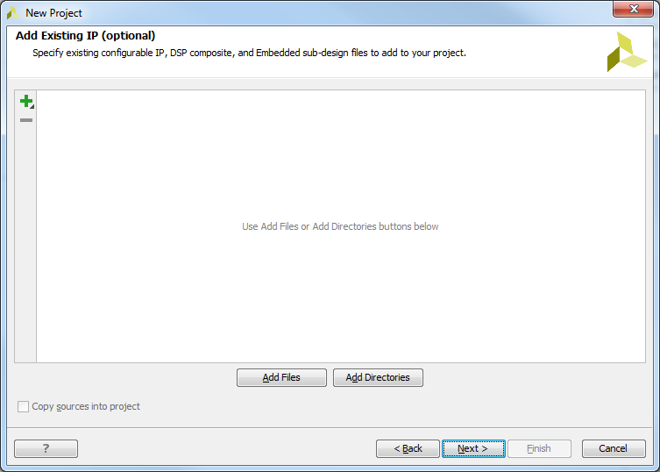
IP will not be added this time

Slide 15
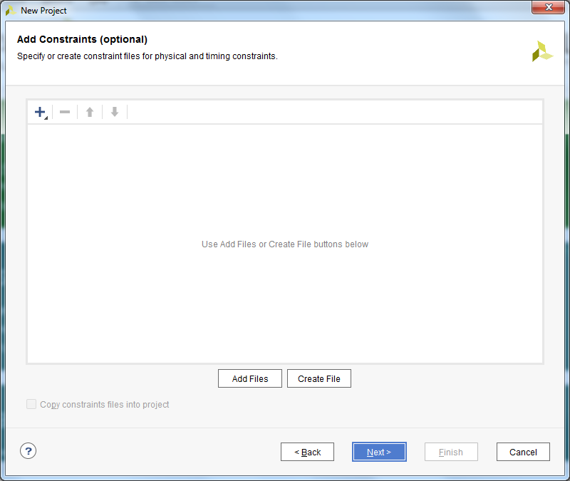
A constraints (.cdx) file will be created later

Slide 16

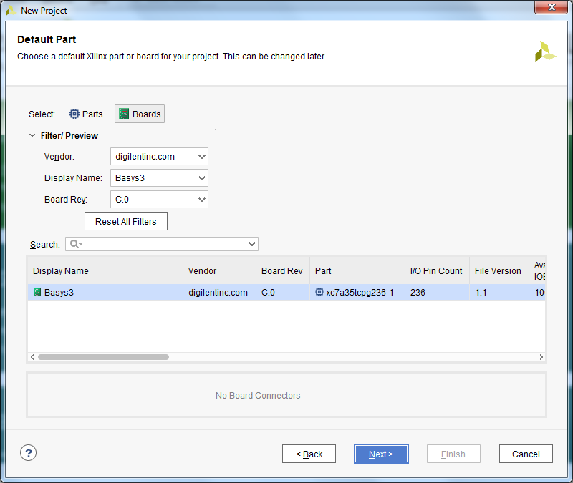
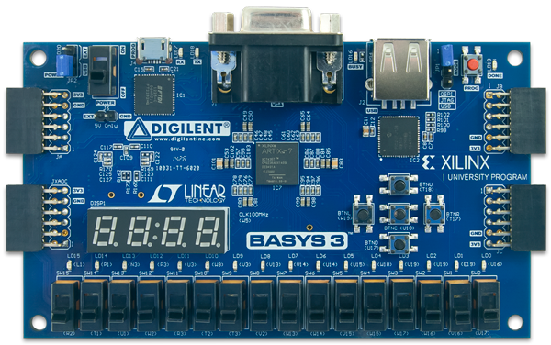
Select the Basys3 board type

Slide 17
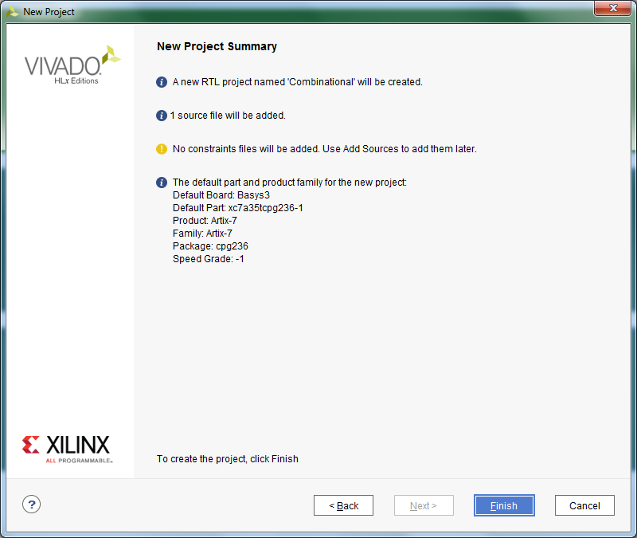
Note the project summary

Slide 18
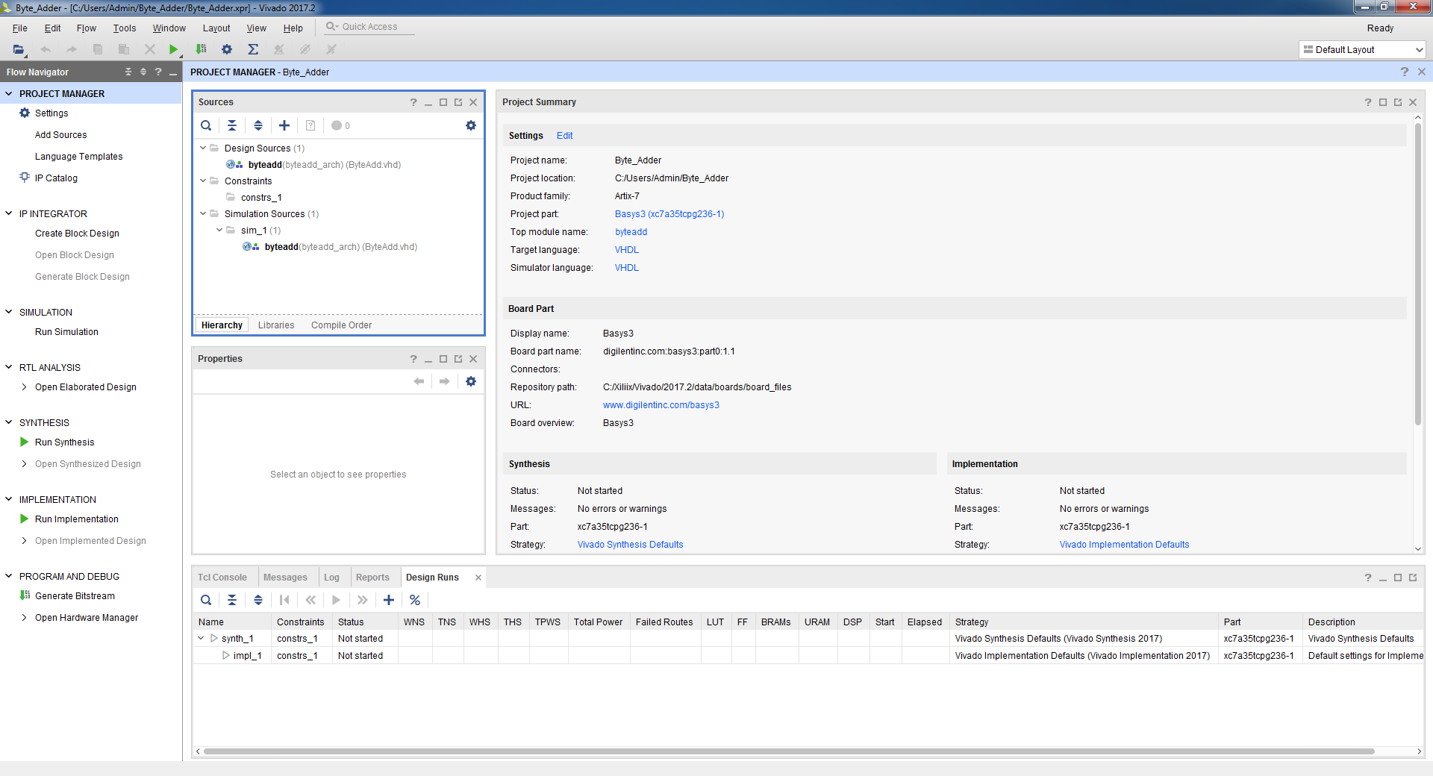
Design environment

Slide 19
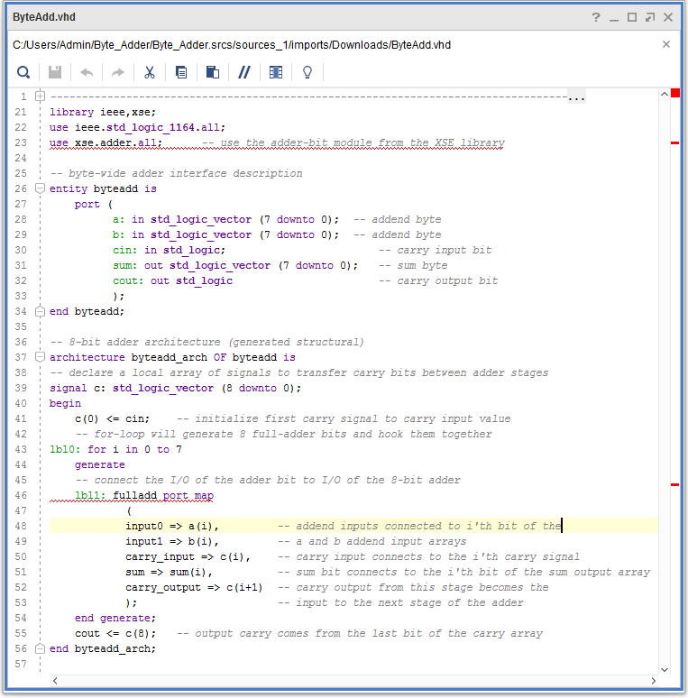
Some points about the ByteAdd module
The USE xse.adder.all statement gives file access to all of the components of the Adder package of the XSE library
The ByteAdd module uses a FOR loop to iteratively instantiate 8 copies of the FullAdd module.
The GENERATE and END GENERATE statements surround the instantiation.
The loop counter, i, indexes the input and output arrays as the loop proceeds.
For example, the 1st time through the loop, the inputs to the FullAdd module are a(0), b(0) and c(0) – which is connected to the carry input on the line c(0) <= cin; The module’s sum and carry outputs are connected to sum(0) and c(1) respectively. The c(1) element connects the carry output from the first adder bit to the carry input of the next adder bit on the next loop iteration.

Slide 20
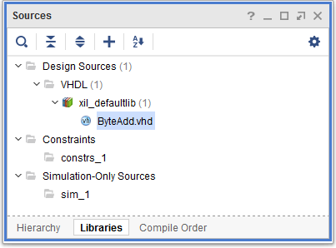
Add library of resources

Slide 21
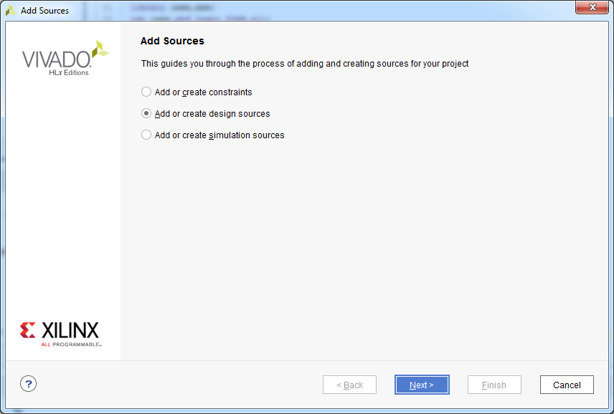
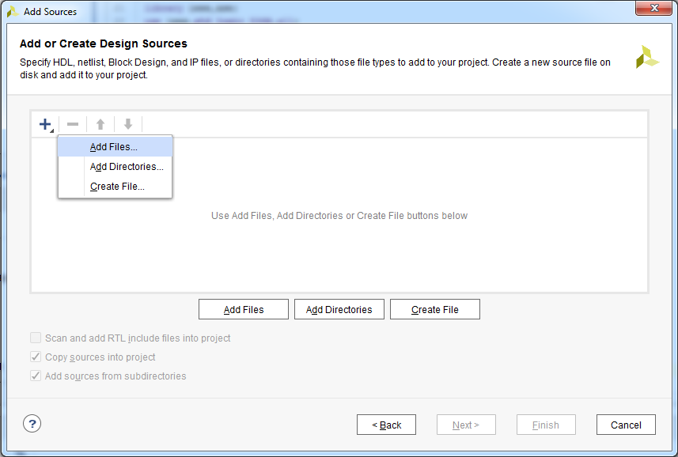
Add a library using “Add a design source”

Slide 22
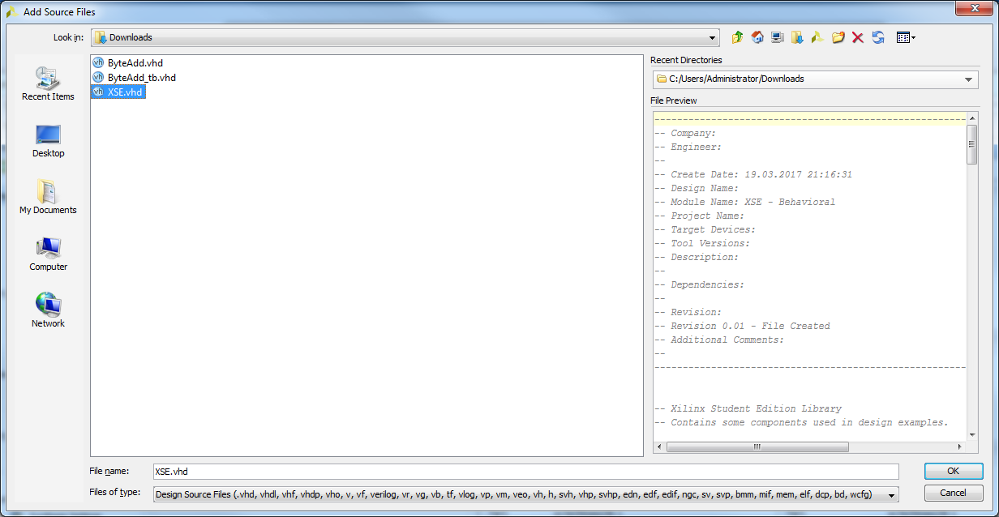
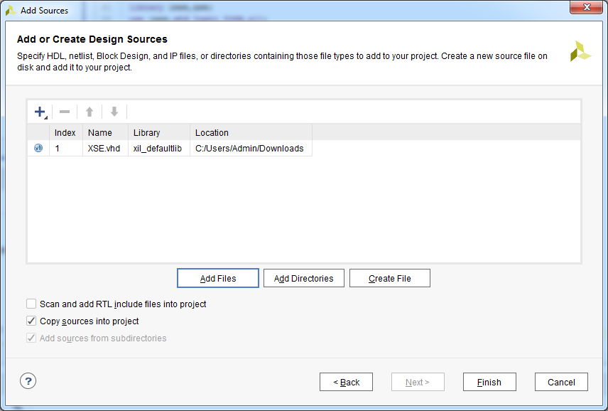
Select XSE.vhd

Slide 23
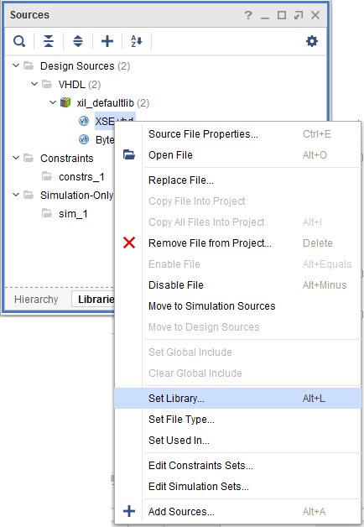
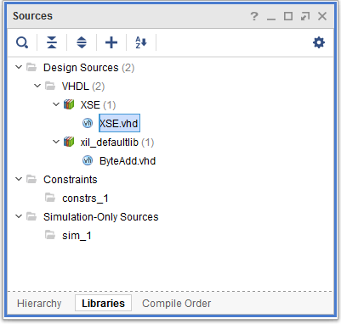
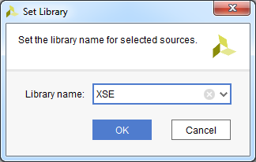
Set the library as XSE.vhd

Slide 24
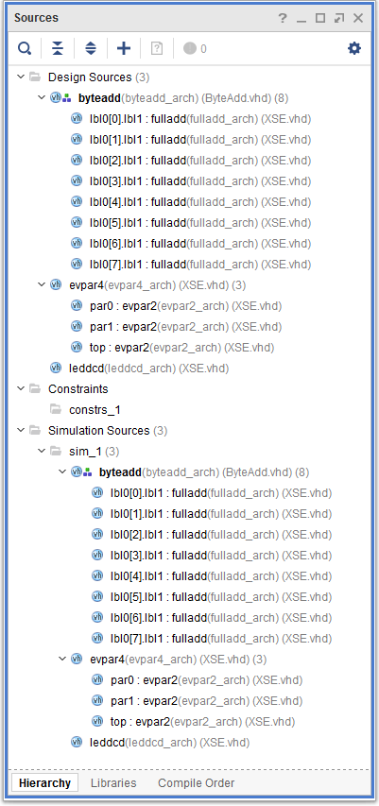

Add a “testbench” simulation source file

Slide 25
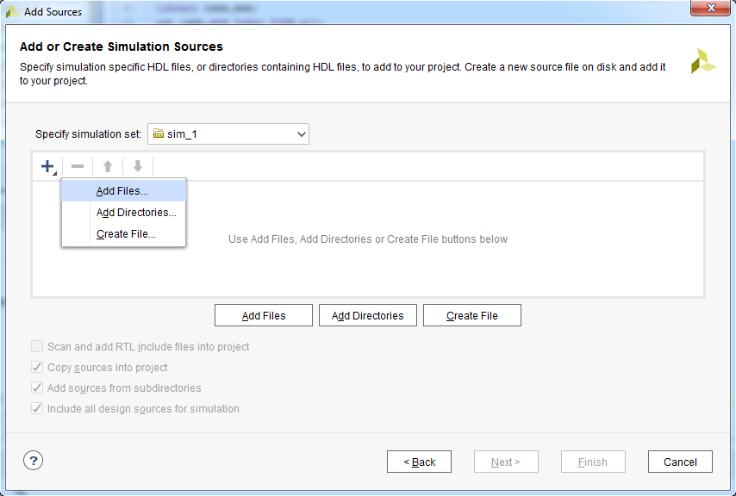
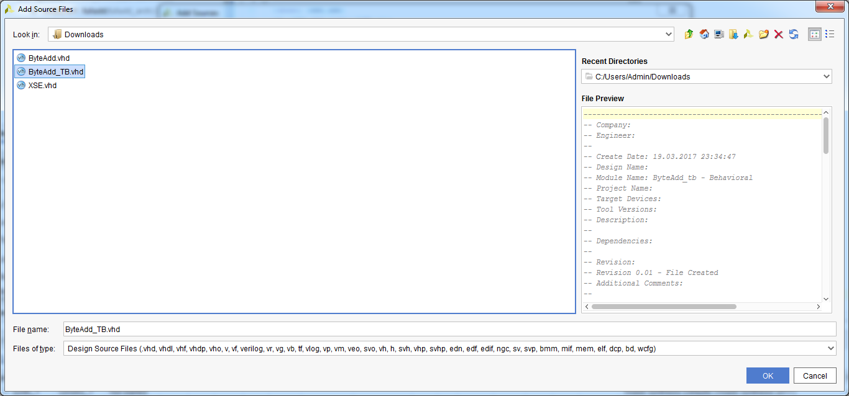
Add the ByteAdd_tb.vhd testbench file

Slide 26
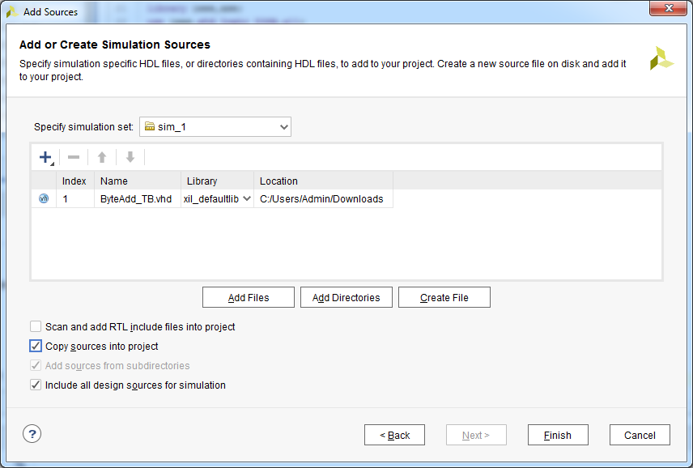
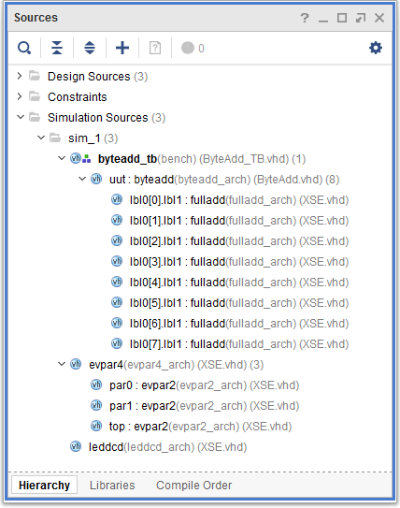
Add the ByteAdd_tb.vhd testbench file

Slide 27
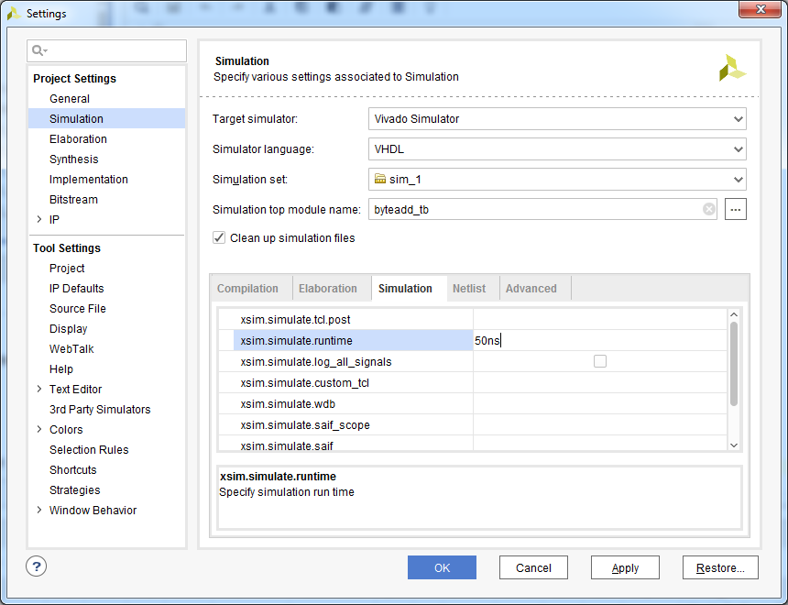
Limit the simulation runtime to 50 ns

Slide 28
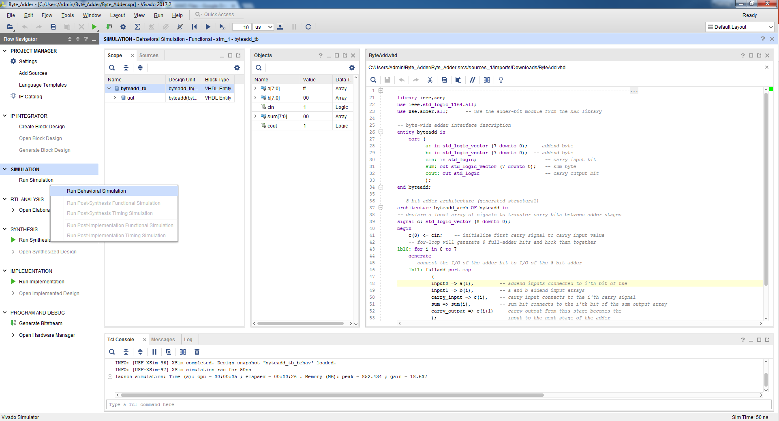
Run behavioural simulation

Slide 29
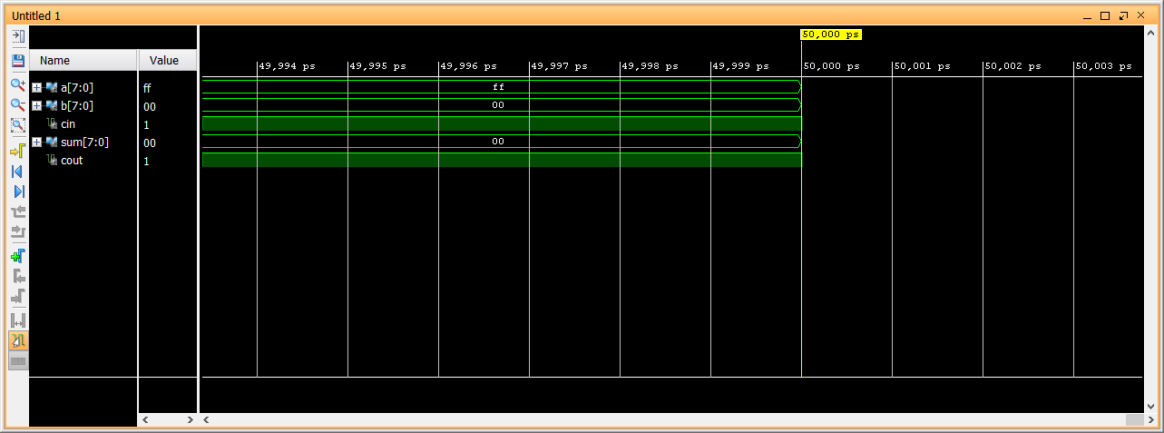
Inspect simulation results

Slide 30
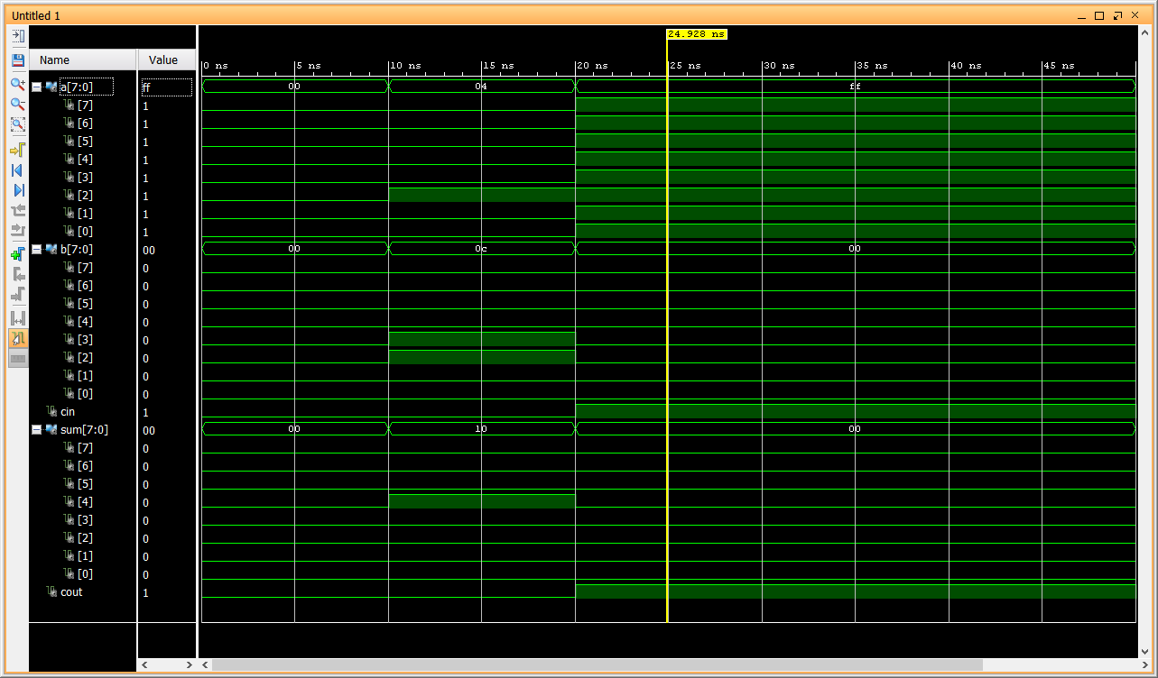
Inspect simulation results
How do the grouped simulated signals reveal the logic of the system?

Slide 31
Amend TestBench
Now, add/amend the code in the ByteAdd_TB.vhd to implement the 8-bit ripple carry test sequence that is illustrated in Side 4
Run the revised simulated testbench and use the slide marker to verify if the simulated design code represents the design code
Copy of the verified simulation result into your report

Slide 32
Complete the truth table for AddByte_TB
a | b | c_{in} | Expected Sum (a+b) | Expected C_{out} | Correct? Y/N
00000000 | 00000000 | 0 | 00000000 | 0 | ?

Slide 33
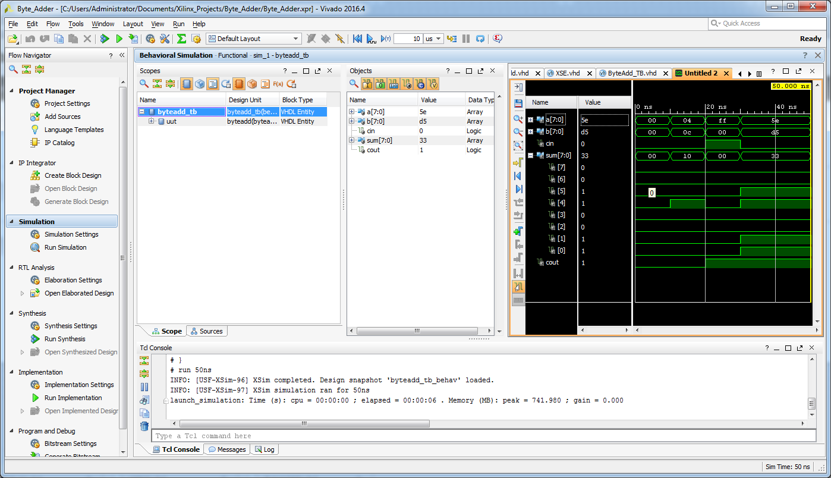
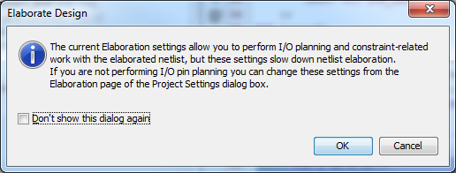
Open Elaborated Design

Slide 34
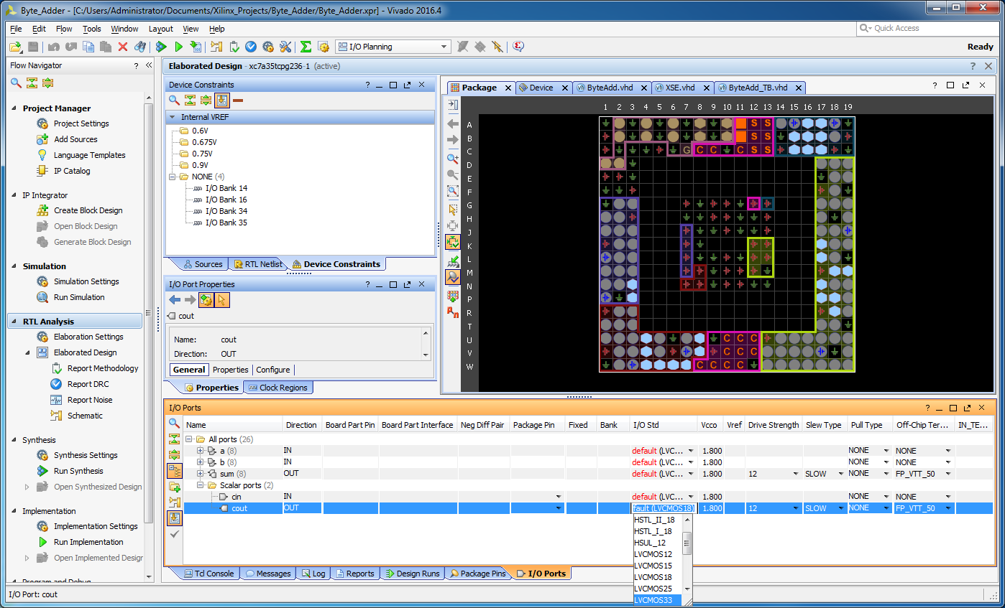
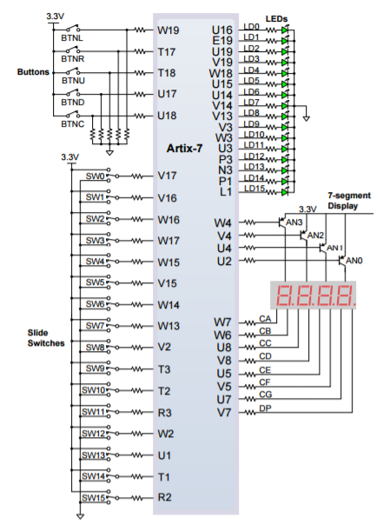
I/O Planning for Basys3 Package

Slide 35
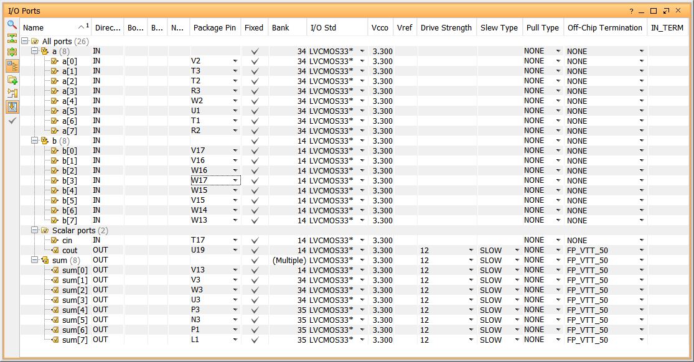
Select the I/O pins and I/O standard

Slide 36
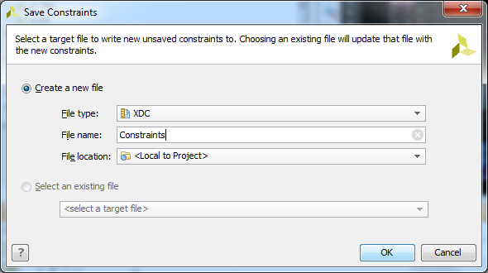
Create a Contraints.xdc file
Press “Cntl” + “s” to create/save a Contraints.xdc file

Slide 37
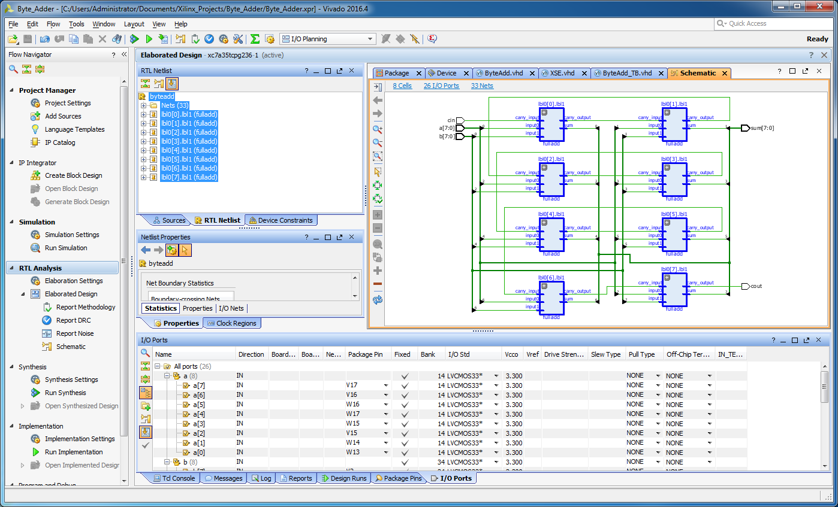
Select RTL Netlist to view the schematic

Slide 38
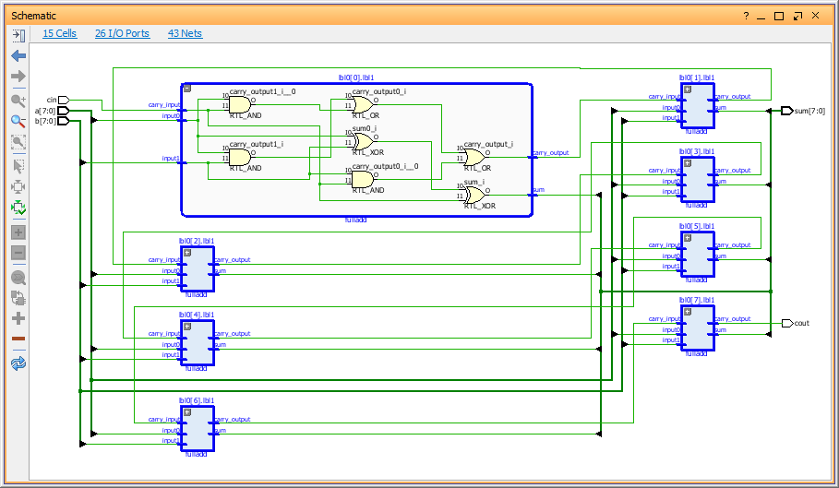
Inspect the RTL Schematic: open sub-circuits
You should get a view of the chain of 8 full adders required to build this 8-bit adder, together with the circuitry required to combine them
Double-Click on a “Fulladd” block to reveal the sub blocks

Slide 39
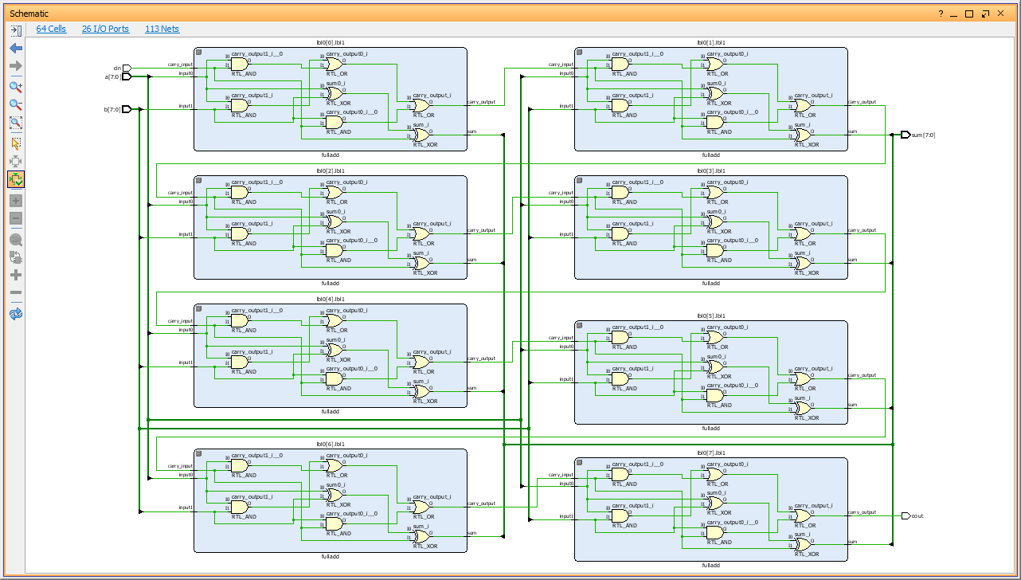
Inspect the RTL Schematic: open sub-circuits
Describe the combinational logic necessary to generate the carry out signal for each Full Adder stage
Have a close look at the RTL Schematic. Note: the carry input (c_{in}) at the top of the diagram feeds into the first full adder
The carry_out from here is the carry_in of the next stage
In this way, the carries ripple through the cascaded circuit

Slide 40
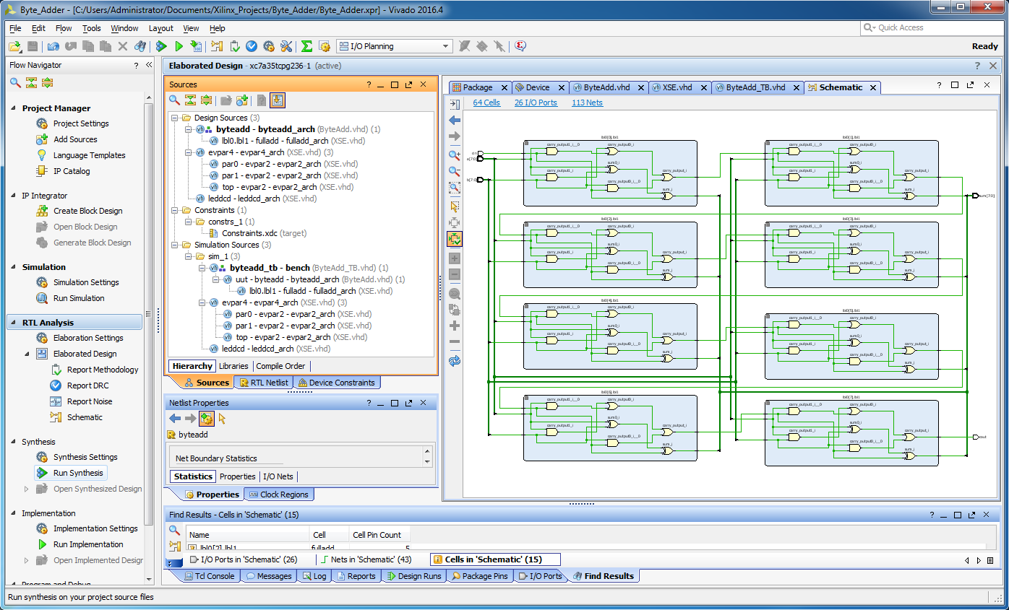
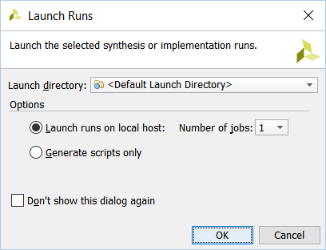
Run synthesis

Slide 41
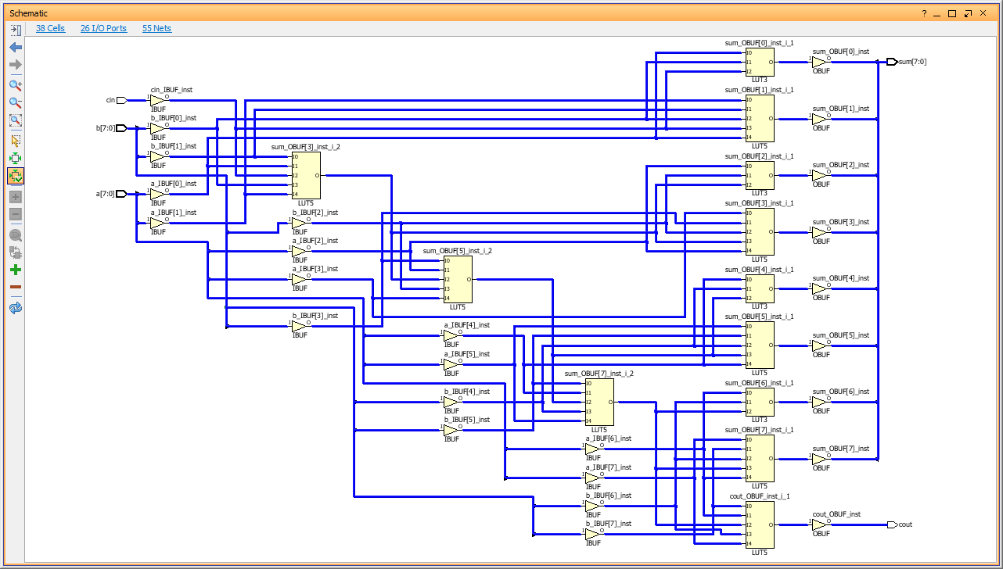
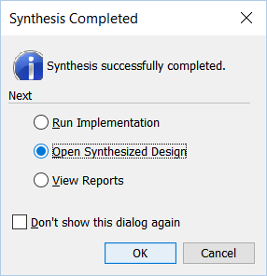
Open synthesized design device layout

Slide 42
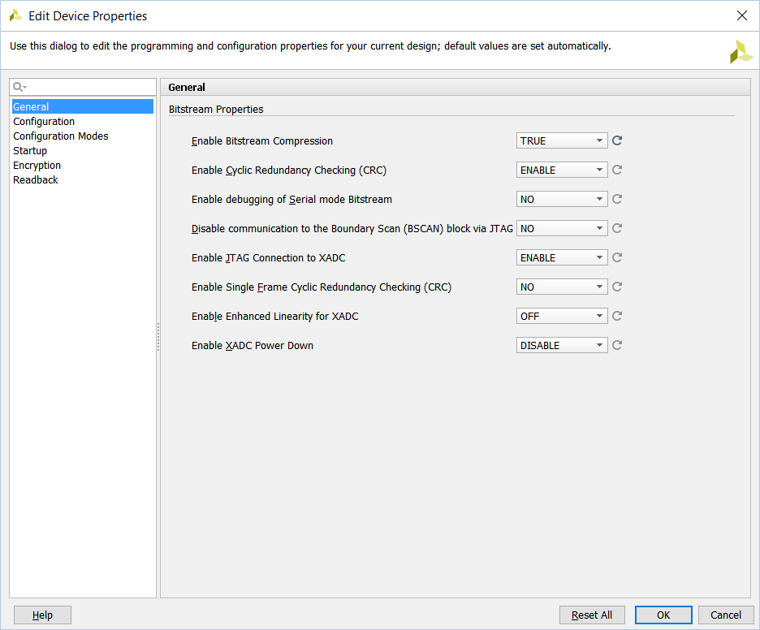
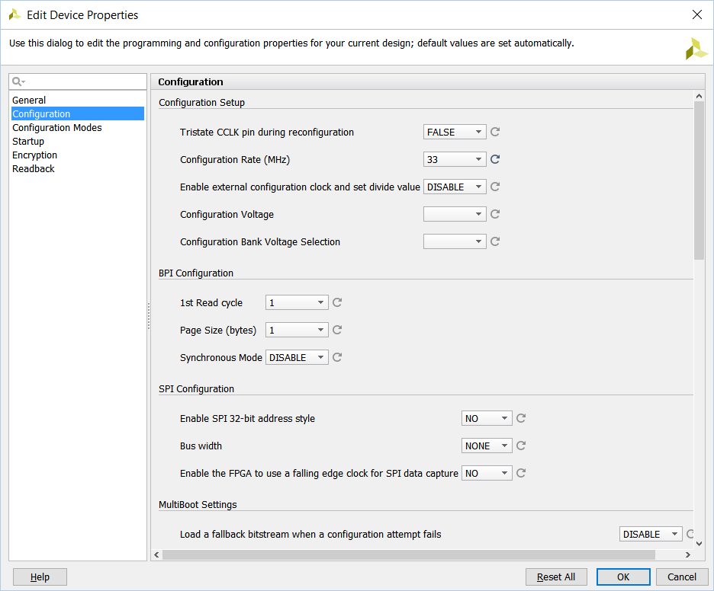
Tools menu: Edit device properties

Slide 43
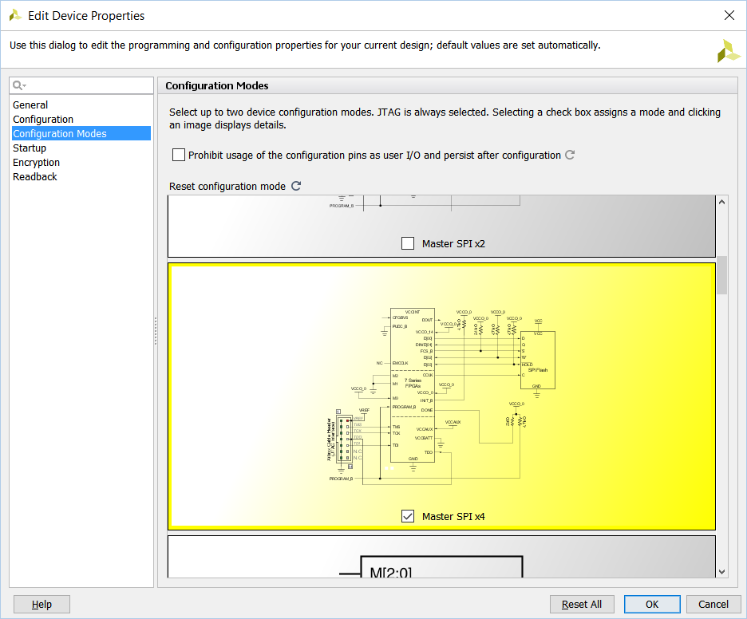
Edit device properties
Serial Peripheral Interface BUS - quad

Slide 44
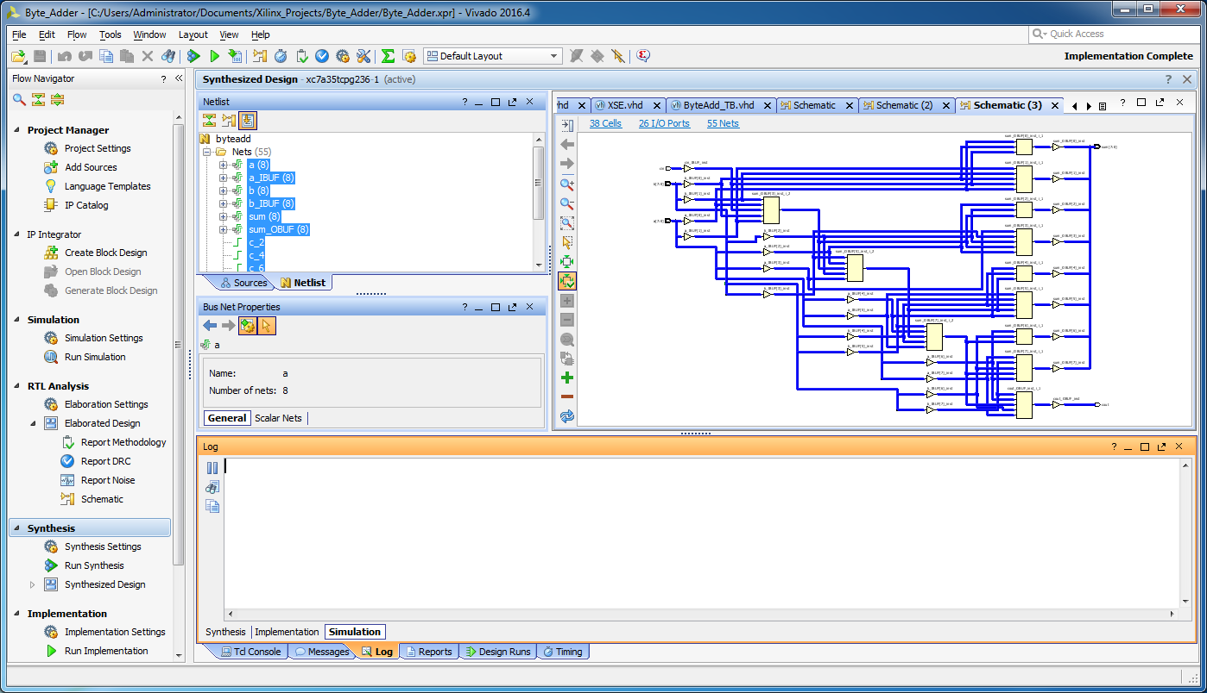
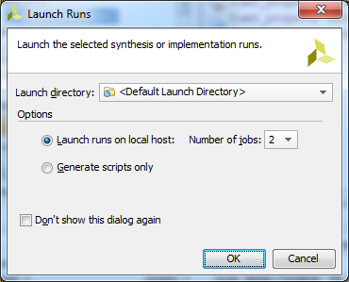
Run implementation

Slide 45
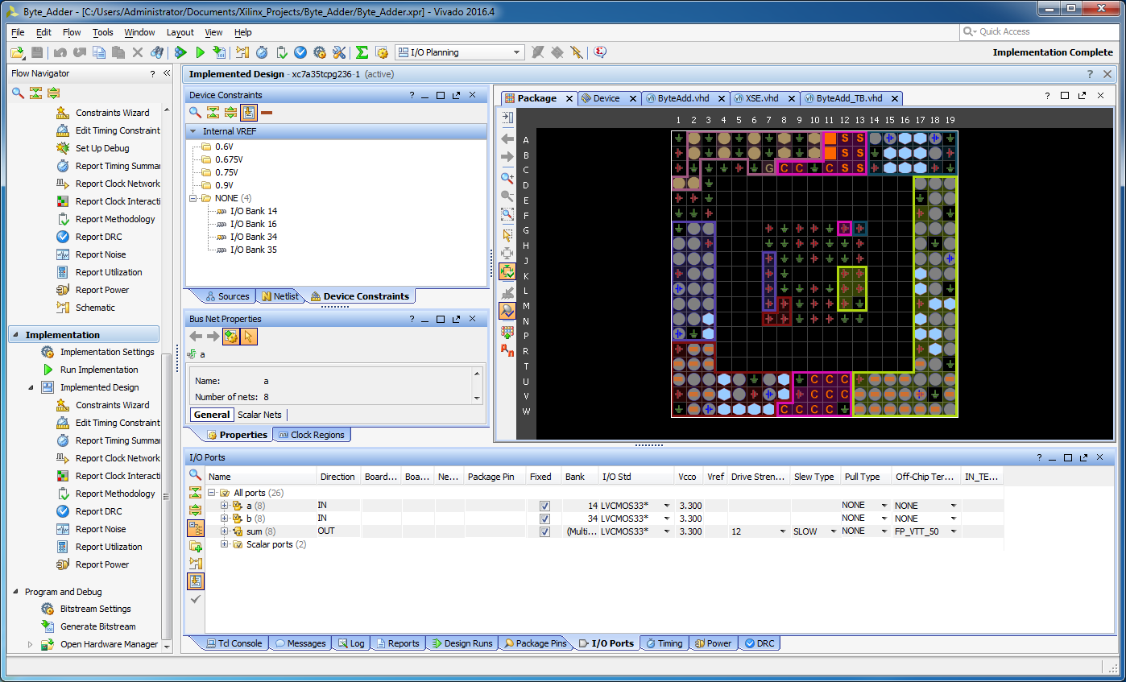
Implemented design

Slide 46
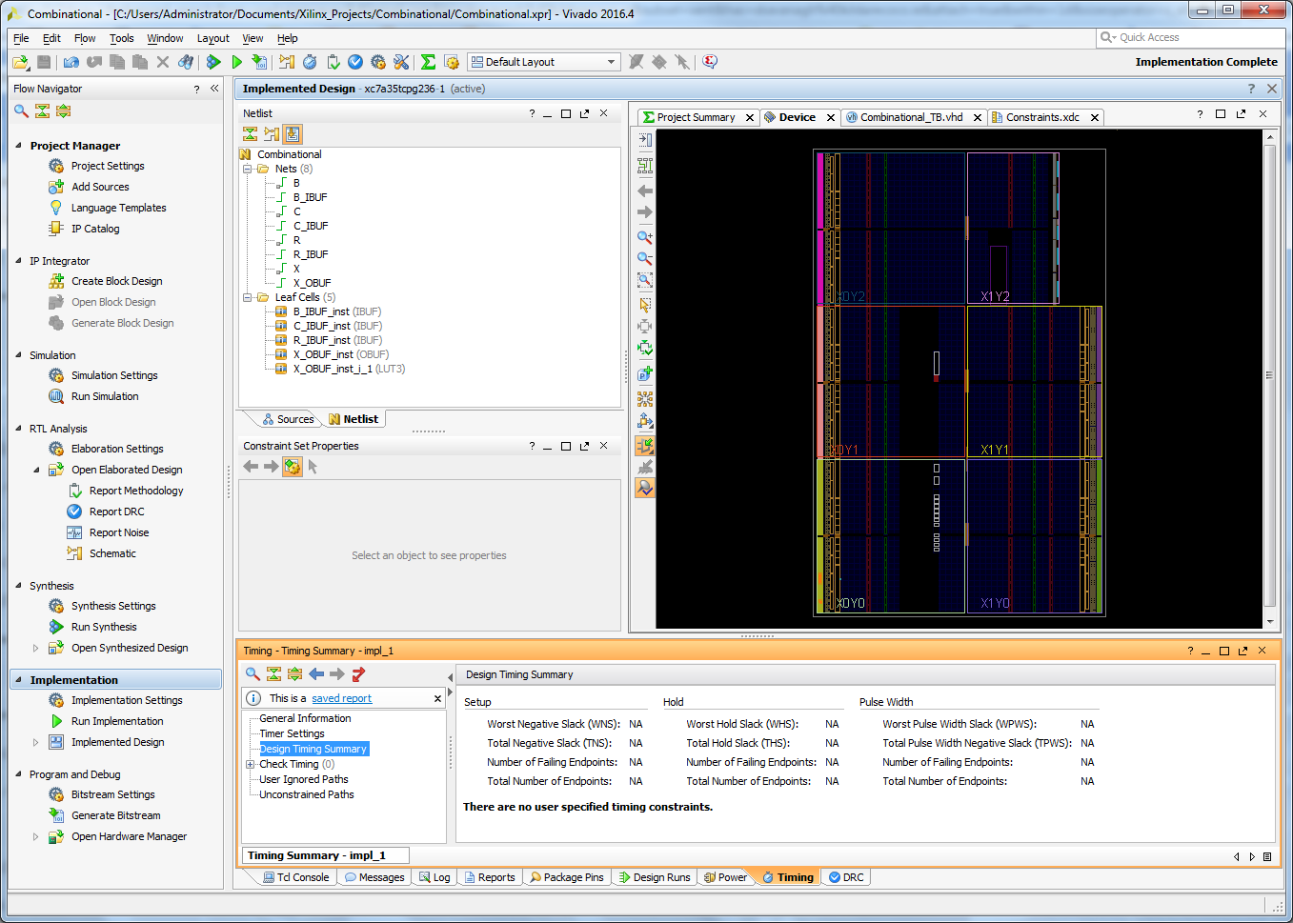

Bitstream settings

Slide 47


Generate bitstream

Slide 48

Basys3 board: configure pins

Slide 49

Basys3 board: configure pins

Slide 50

Basys3 board: configure pin 10 and power on
To select the JTAG setting, place jumper on middle pair of the four pins.
(Note: QSPI setting is illustrated)
1
JP1
MODE

Slide 51


Open target

Slide 52


Open hardware target

Slide 53


Open hardware target

Slide 54

Program device

Slide 55

Write Bitstream (.bit file) to device

Slide 56
Does the programme work properly?
Report:
Apply signals via switches [SW15 - SW0] to verify that the planned design works
Use a photograph to illustrate the LEDs for the amended testbench sequence
Label your selected switch configurations in your report
How does c_{in} = 1 change the result? Use the Right Button BNTR (T17) to test it
Add a photograph with c_{in} = 1

Slide 57
Completing your report
Upload your report to Brightspace
Open Windows Explorer and create a compression data file of your combinational logic folder to produce EightBitAdder.zip, or EightBitAdder.rar
Upload your compressed .zip or .rar file to Brightspace

